Slide 1
The Art of the Self Portrait

Slide 2
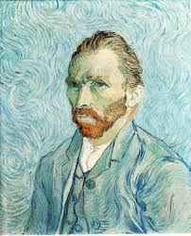
The Self Portrait

Slide 3
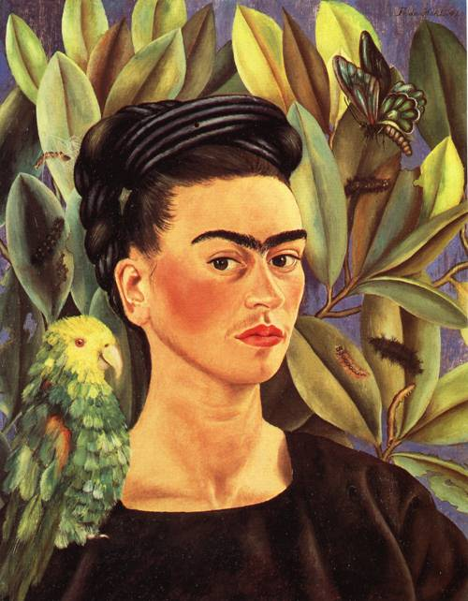
The Self Portrait

Slide 4
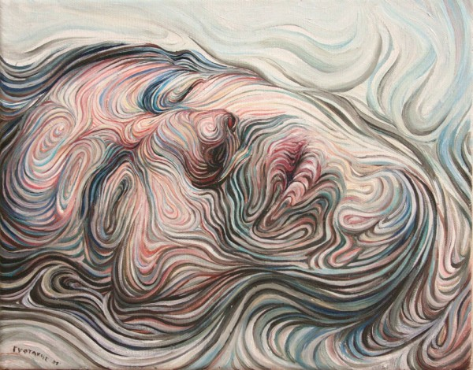
The Self Portrait

Slide 5
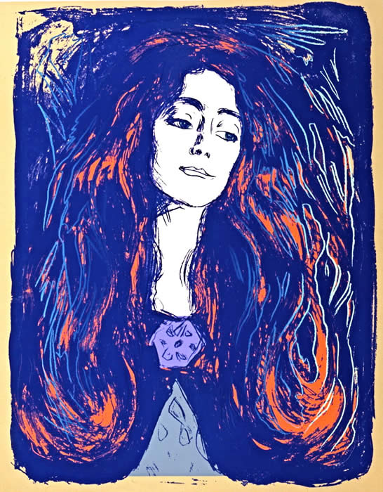
The Self Portrait

Slide 6
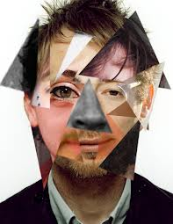
The Self Portrait

Slide 7
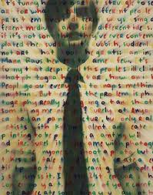
The Self Portrait

Slide 8
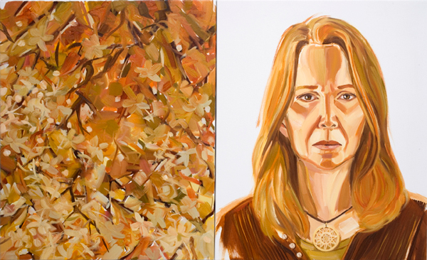
The Self Portrait

Slide 9
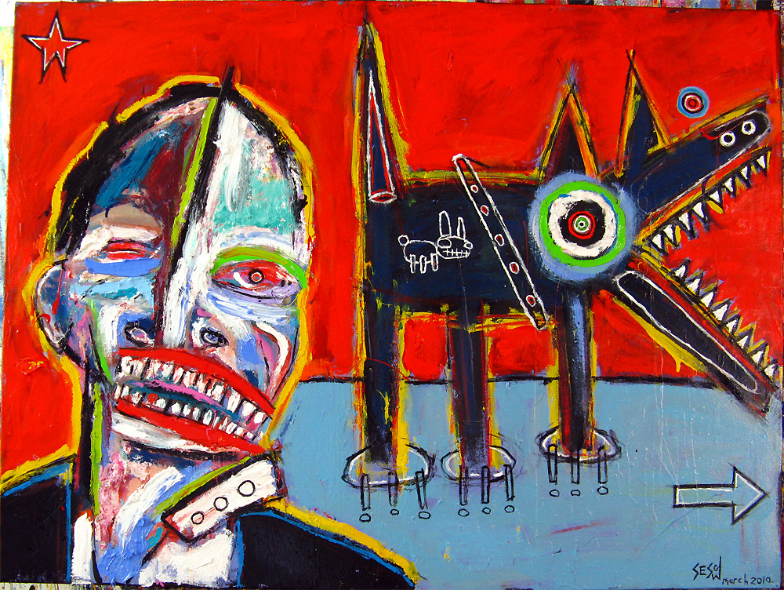
The Self Portrait

Slide 10
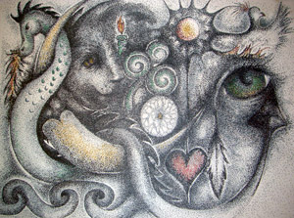
The Self Portrait

Slide 11
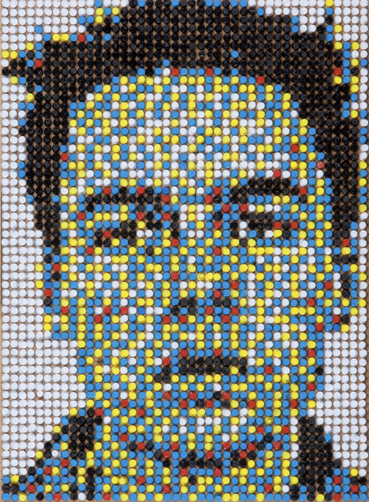
The Self Portrait

Slide 12
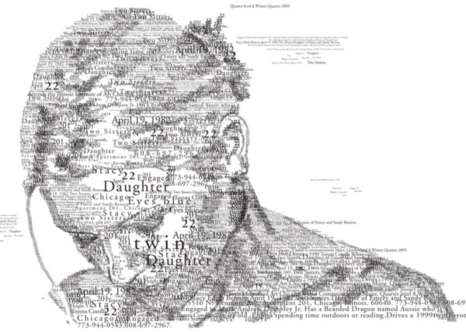
The Self Portrait

Slide 13
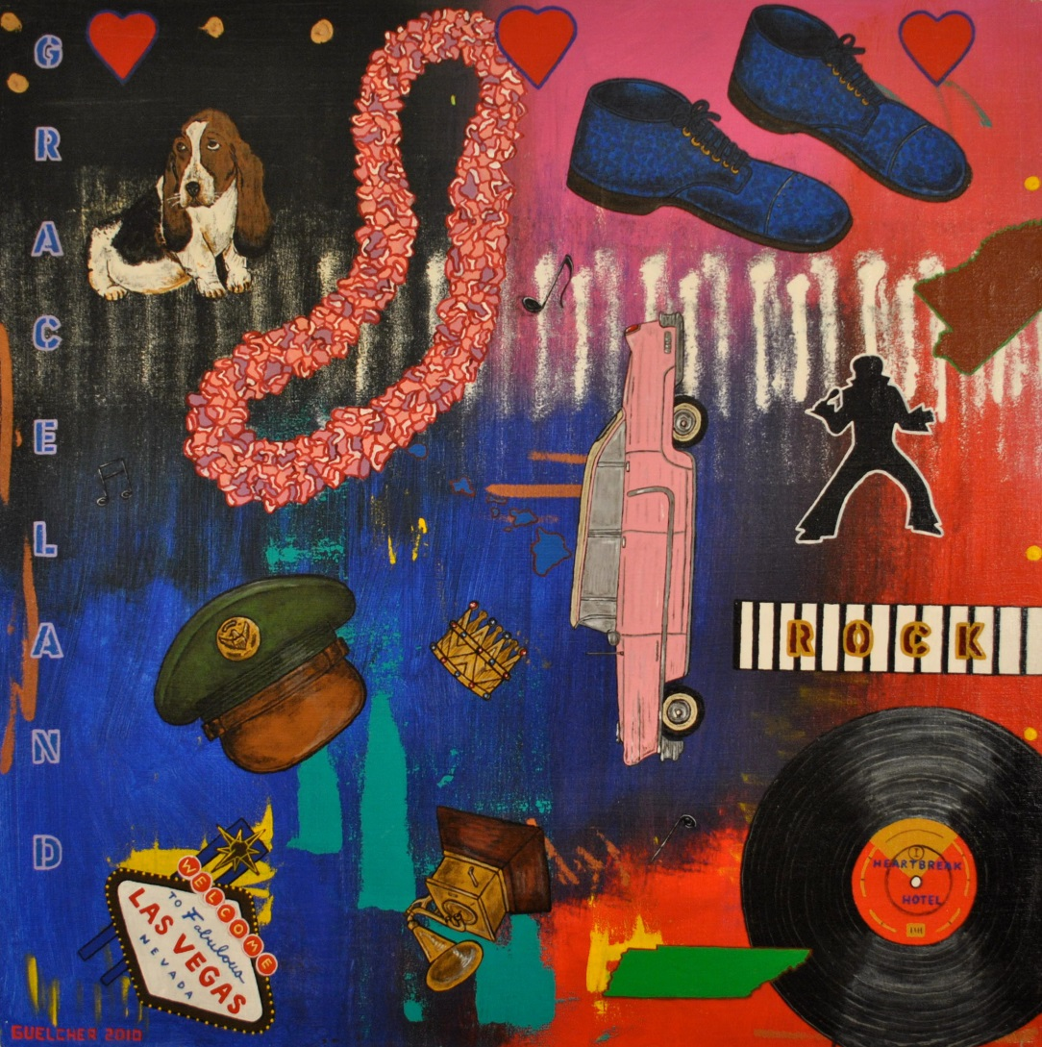
Mr. Guelcher’s Example

Slide 14
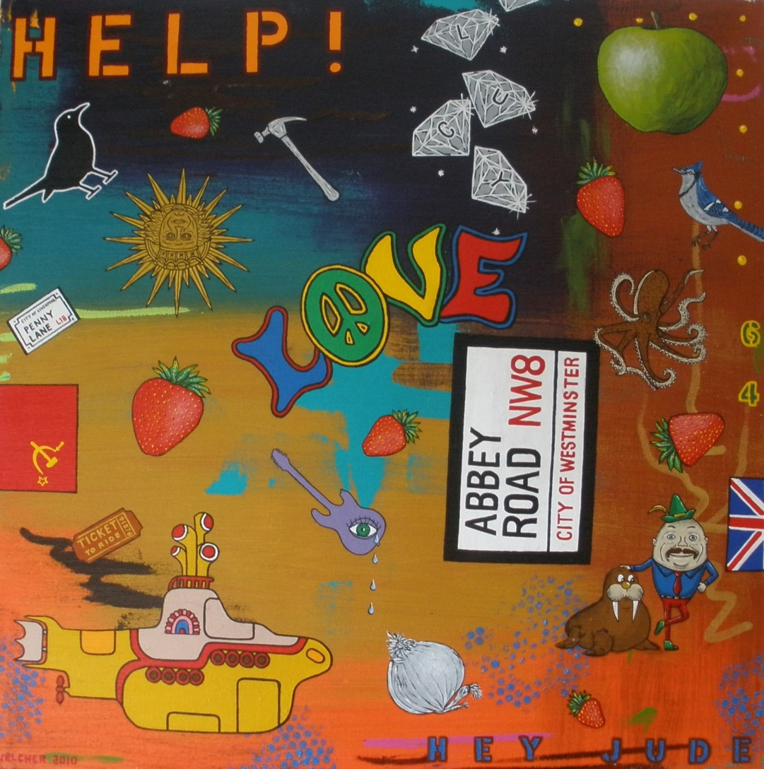
Mr. Guelcher’s Example

Slide 15
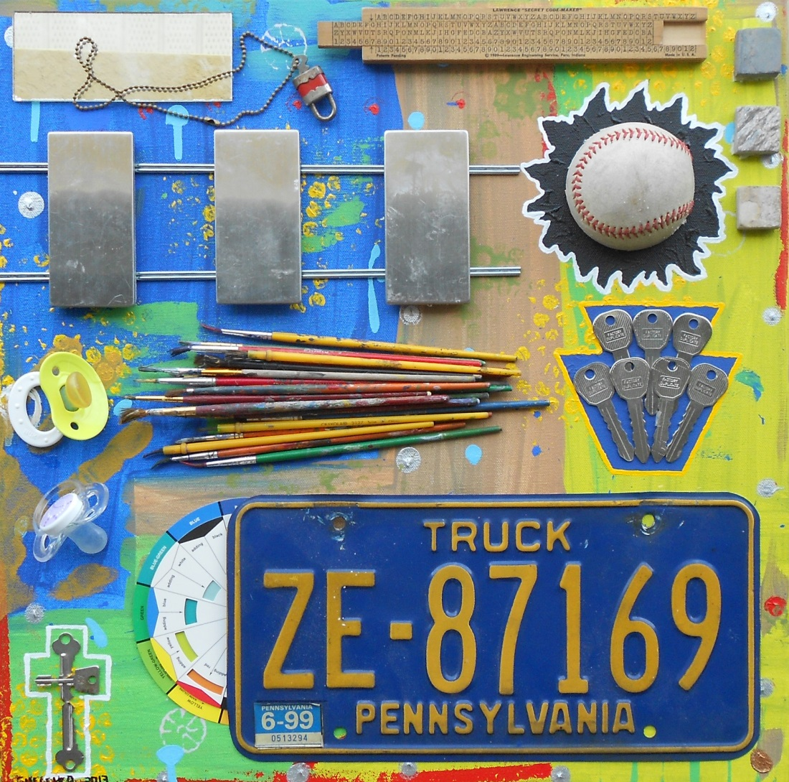
Mr. Guelcher’s Self Portrait

Slide 16
Demonstration

