Slide 1
Impressionism

Slide 2
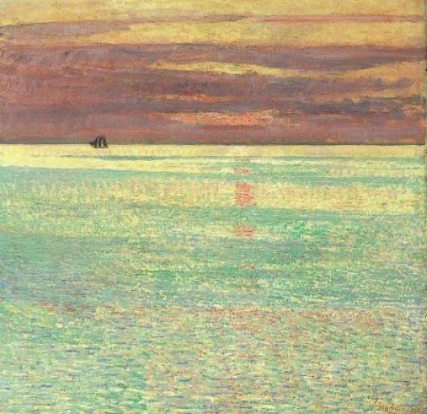
Impressionism

Slide 3
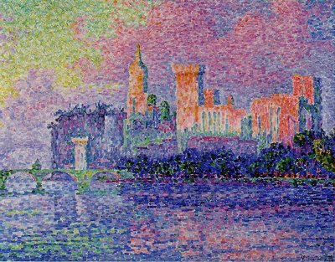
Impressionism

Slide 4
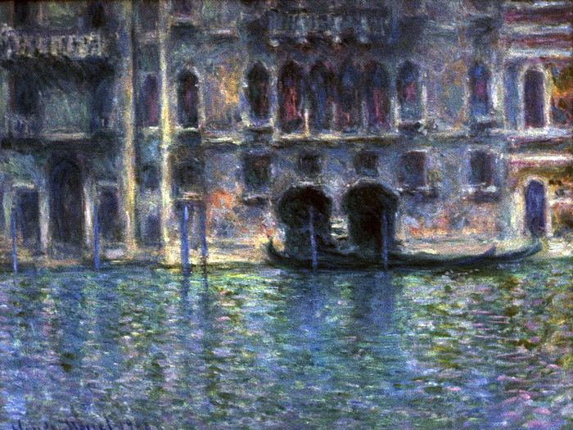
Impressionism

Slide 5
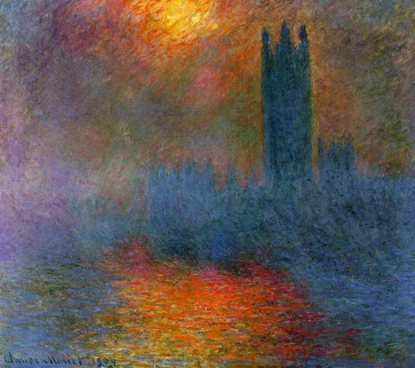
Impressionism

Slide 6
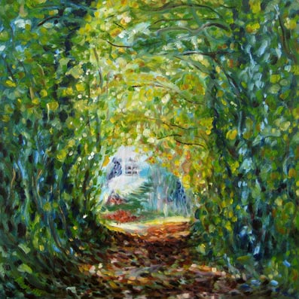
Impressionism

Slide 7
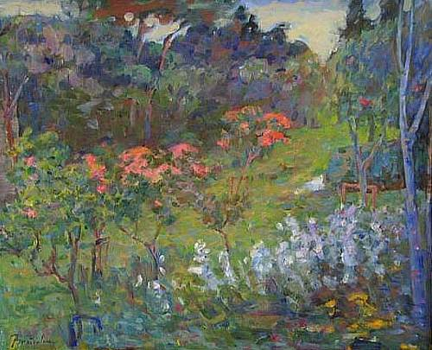
Impressionism

Slide 8
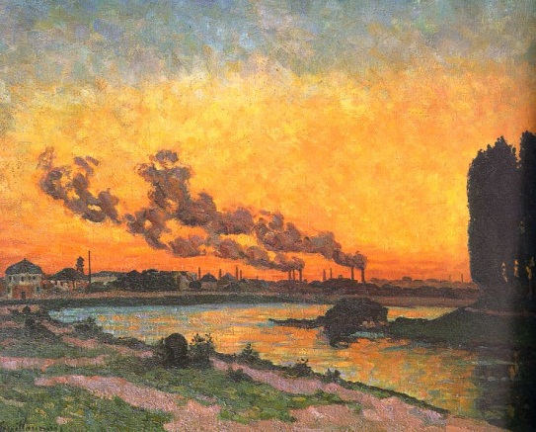
Impressionism

Slide 9
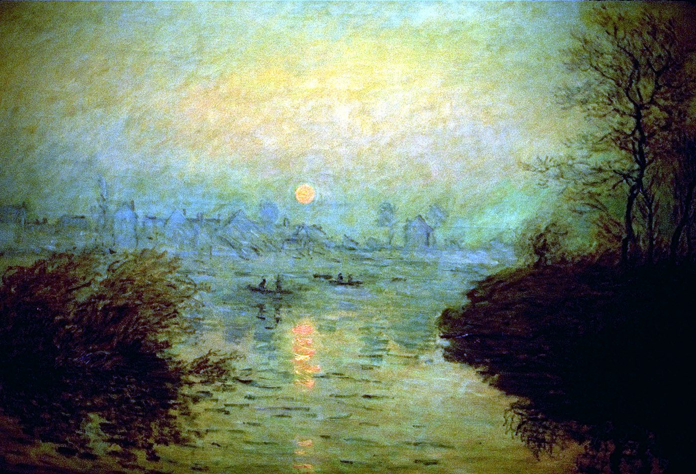
Impressionism

Slide 10
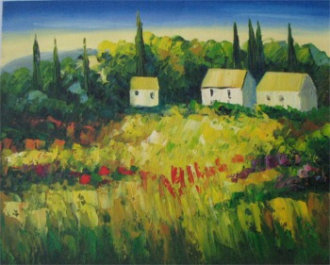
Impressionism

Slide 11
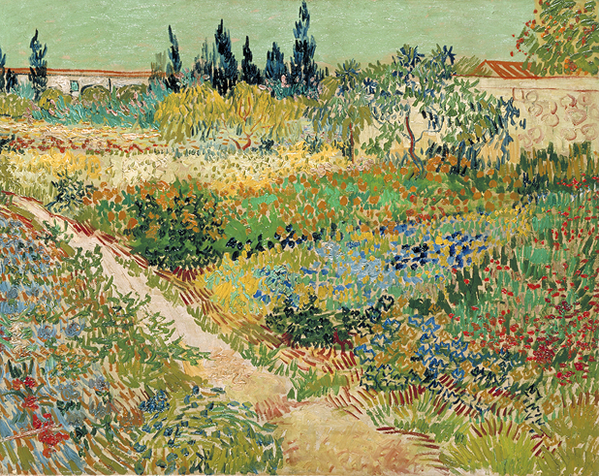
Impressionism

Slide 12
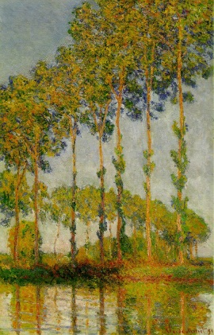
Impressionism

Slide 13
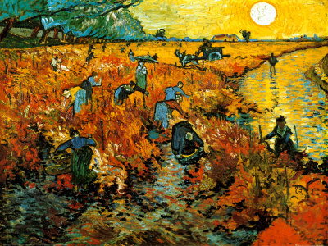
Impressionism

Slide 14
Impressionism Project
Lesson: Impressionism
Objectives: Student is to complete a landscape using impressionism techniques with watercolor. Create a composition that is interesting and appealing. Student is to use all artistic techniques correctly. Student is to follow all directions and guidelines.
Materials: Paper, Pencil, Ruler, watercolor
Focus/Model: Claude Monet along with other impressionist artworks
Vocabulary: Dry Brush, Impressionism, Washes, Landscape, Pigments
Procedure: Start by drawing your composition in pencil so that you can erase all the extra lines that are not to be painted. Next you should complete your painting by using the watercolor to color your picture. Don’t forget to use the different techniques in Impressionism

Slide 15
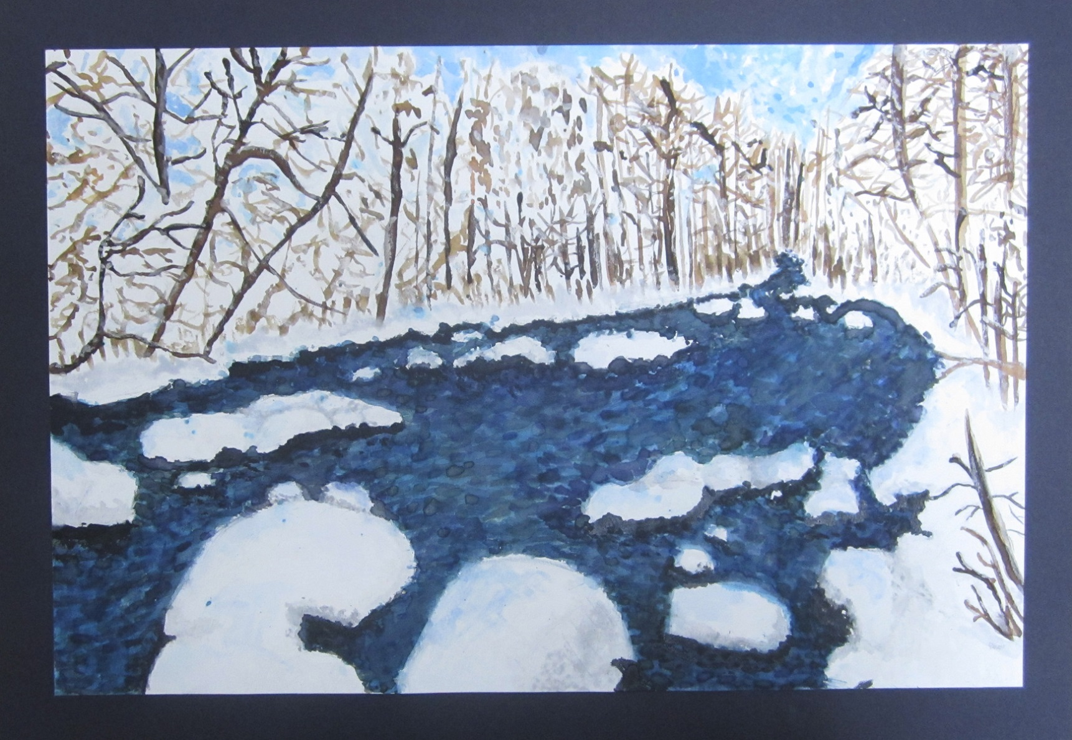
Student Artwork

Slide 16
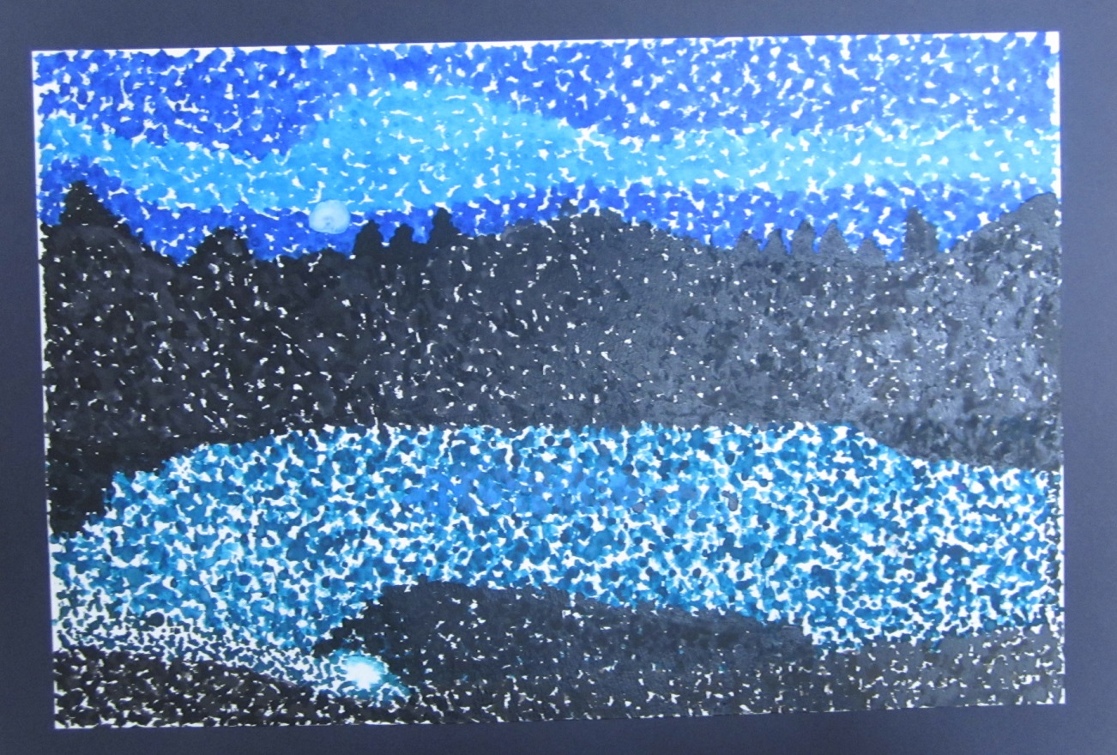
Student Artwork

Slide 17
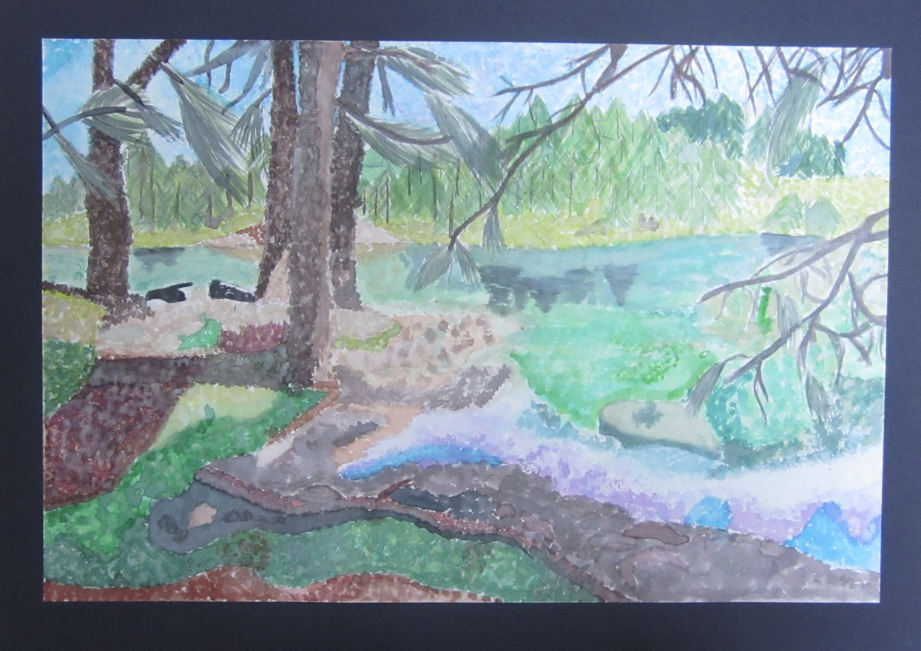
Student Artwork

Slide 18
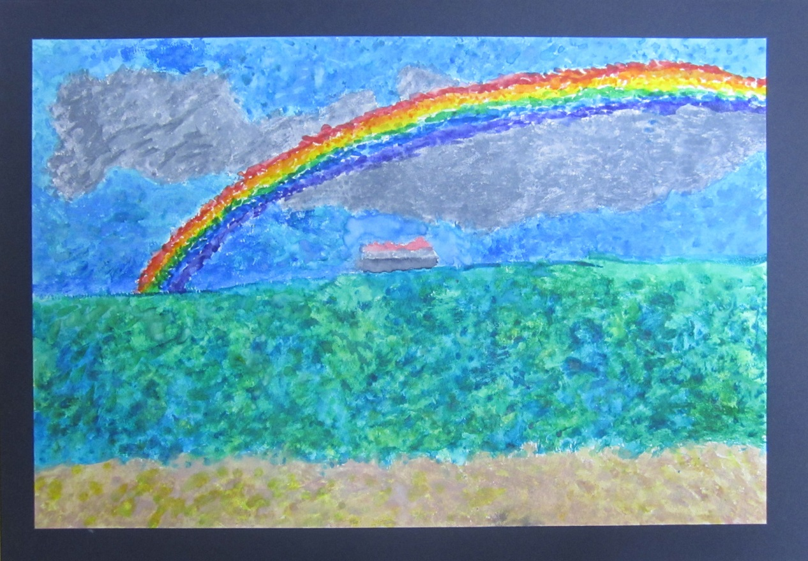
Student Artwork

Slide 19
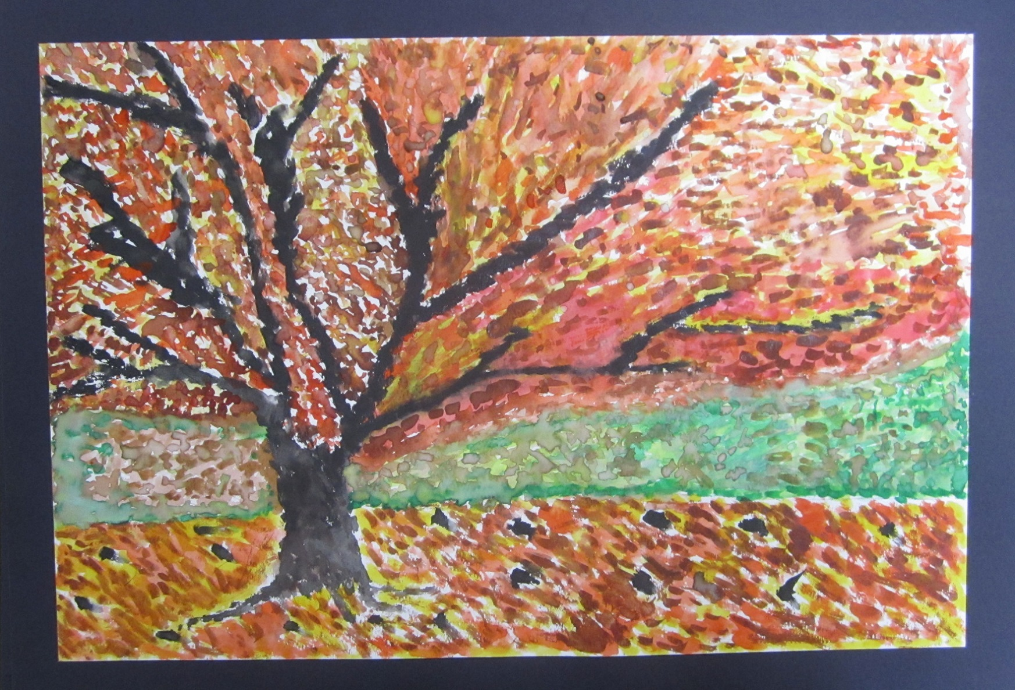
Student Artwork

Slide 20
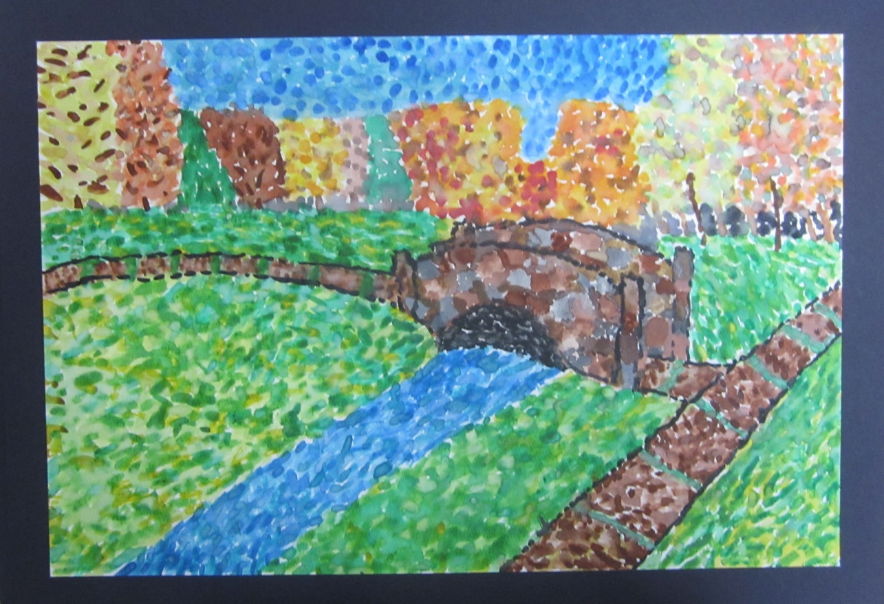
Student Artwork

Slide 21
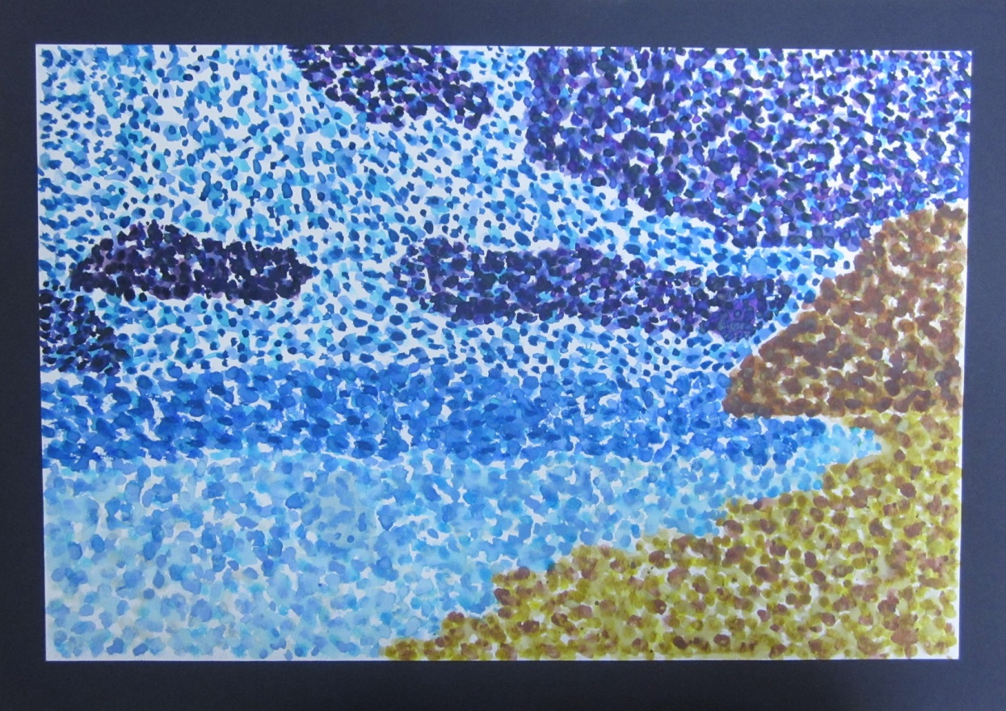
Student Artwork

Slide 22
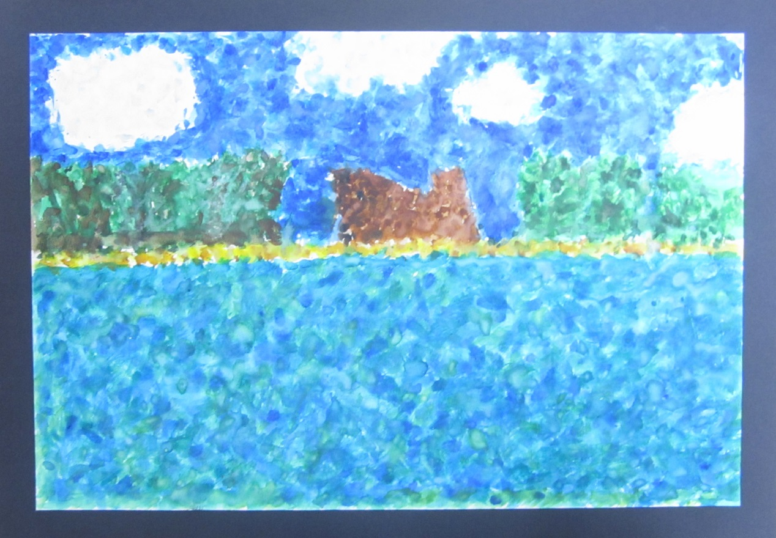
Student Artwork

Slide 23
Your Turn……

