Slide 1
Gothic Art
Drawing II

Slide 2
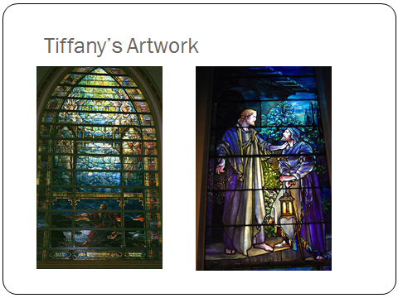
Stained Glass

Slide 3
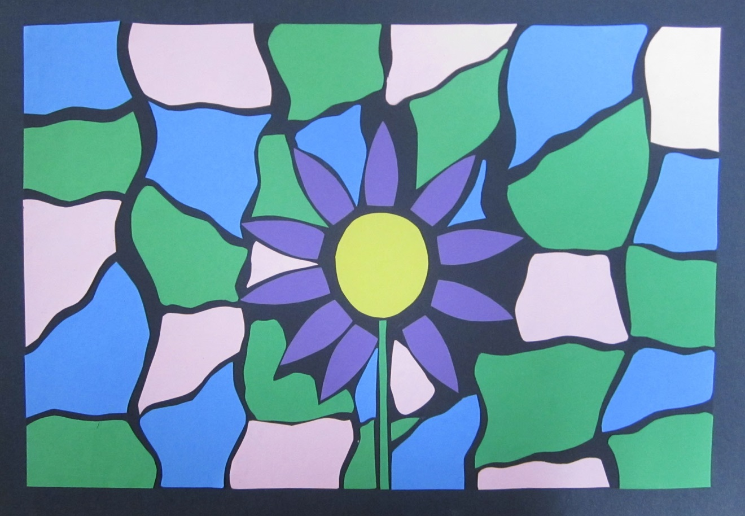
Student Examples

Slide 4

Student Examples

Slide 5
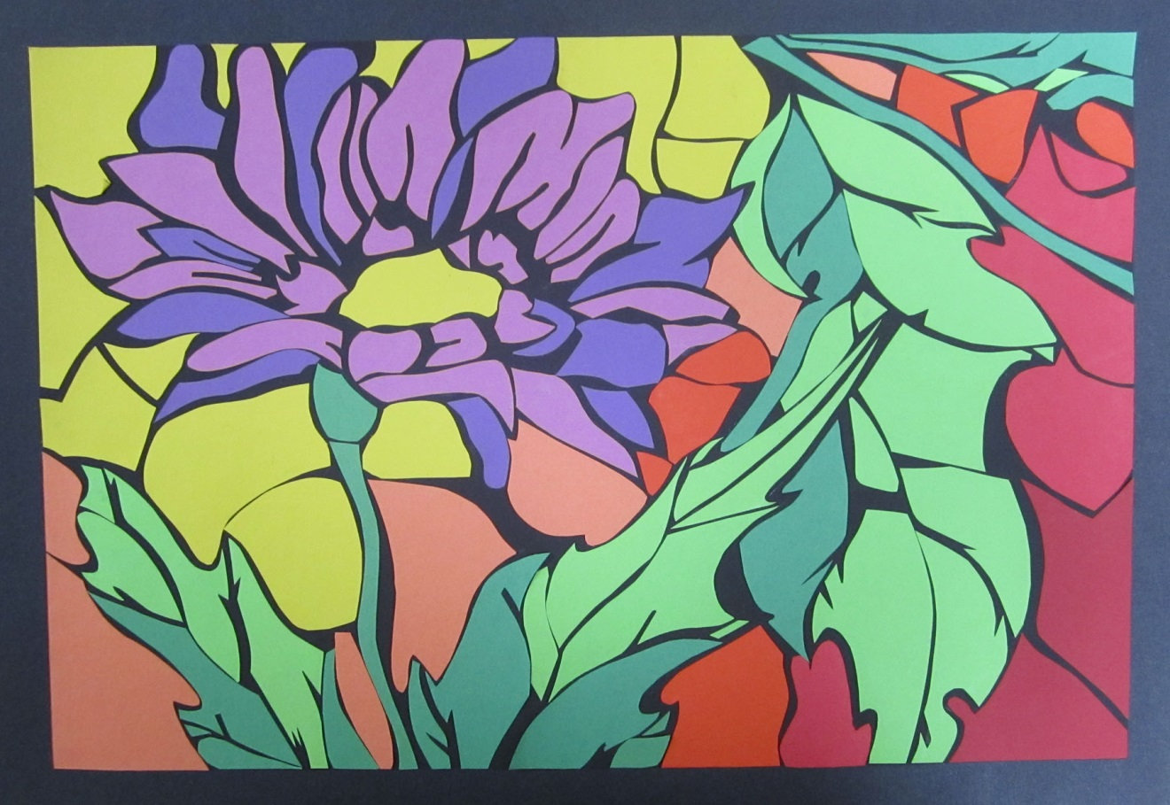
Student Examples

Slide 6
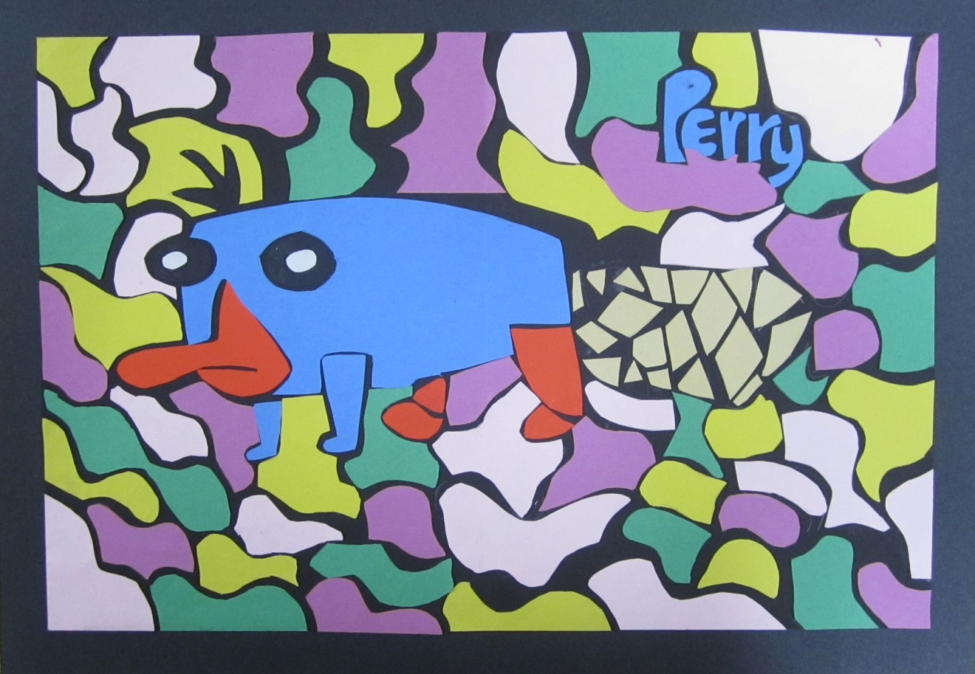
Student Examples

Slide 7

Student Examples

Slide 8

Student Examples

Slide 9
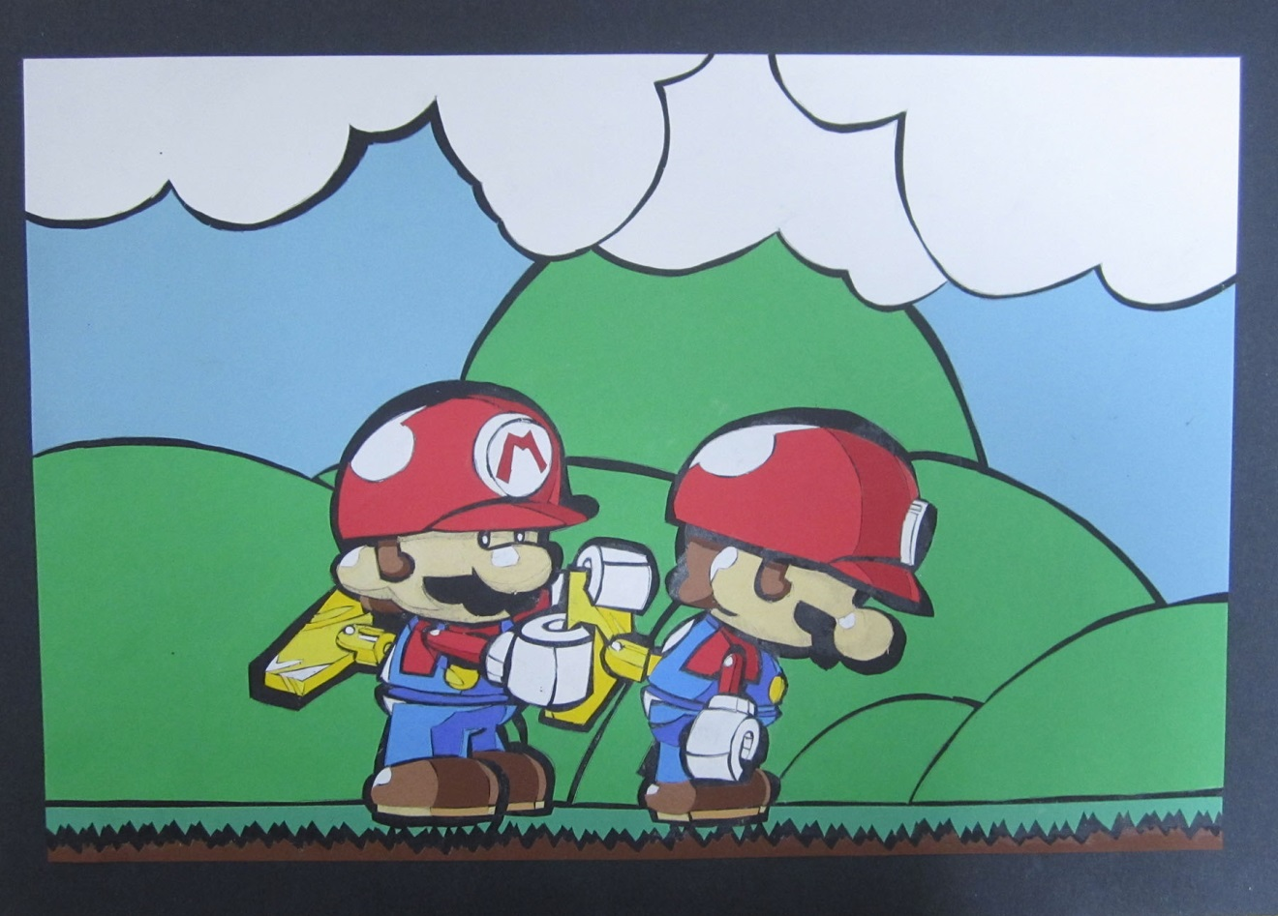
Student Examples

Slide 10
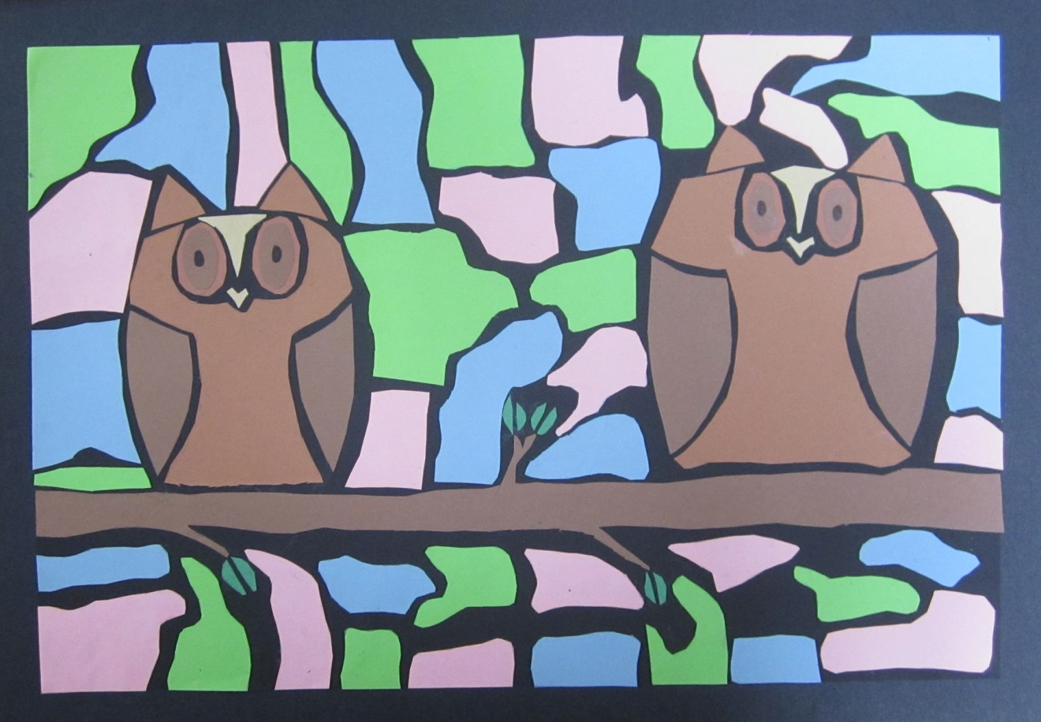
Student Examples

Slide 11
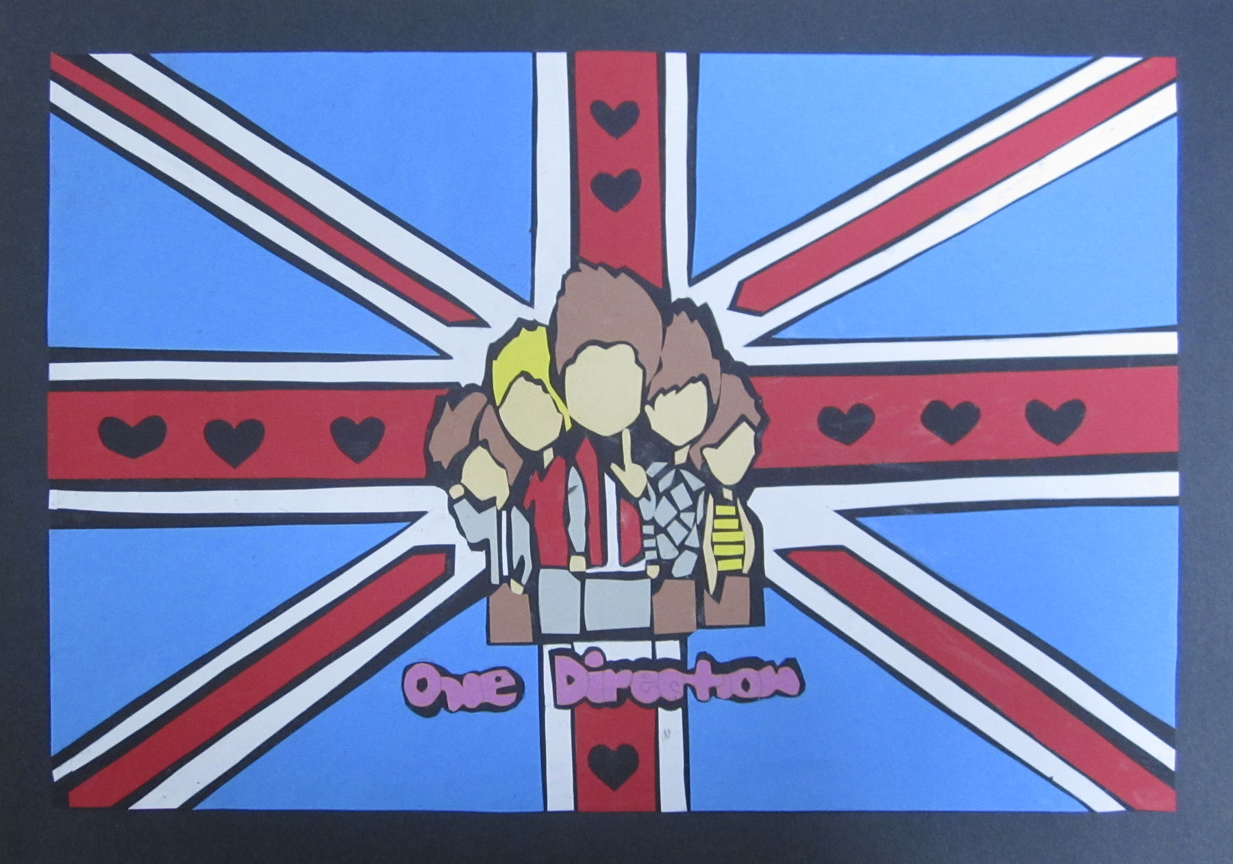
Student Examples

Slide 12

Student Examples

Slide 13
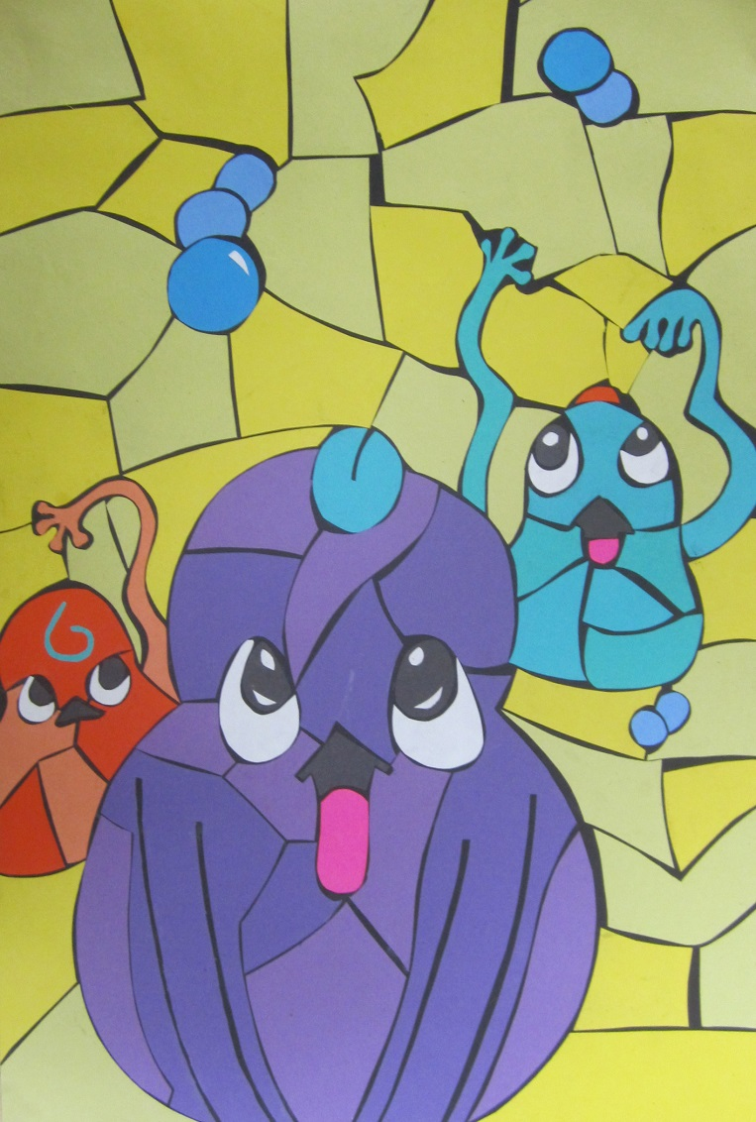
Student Examples

Slide 14
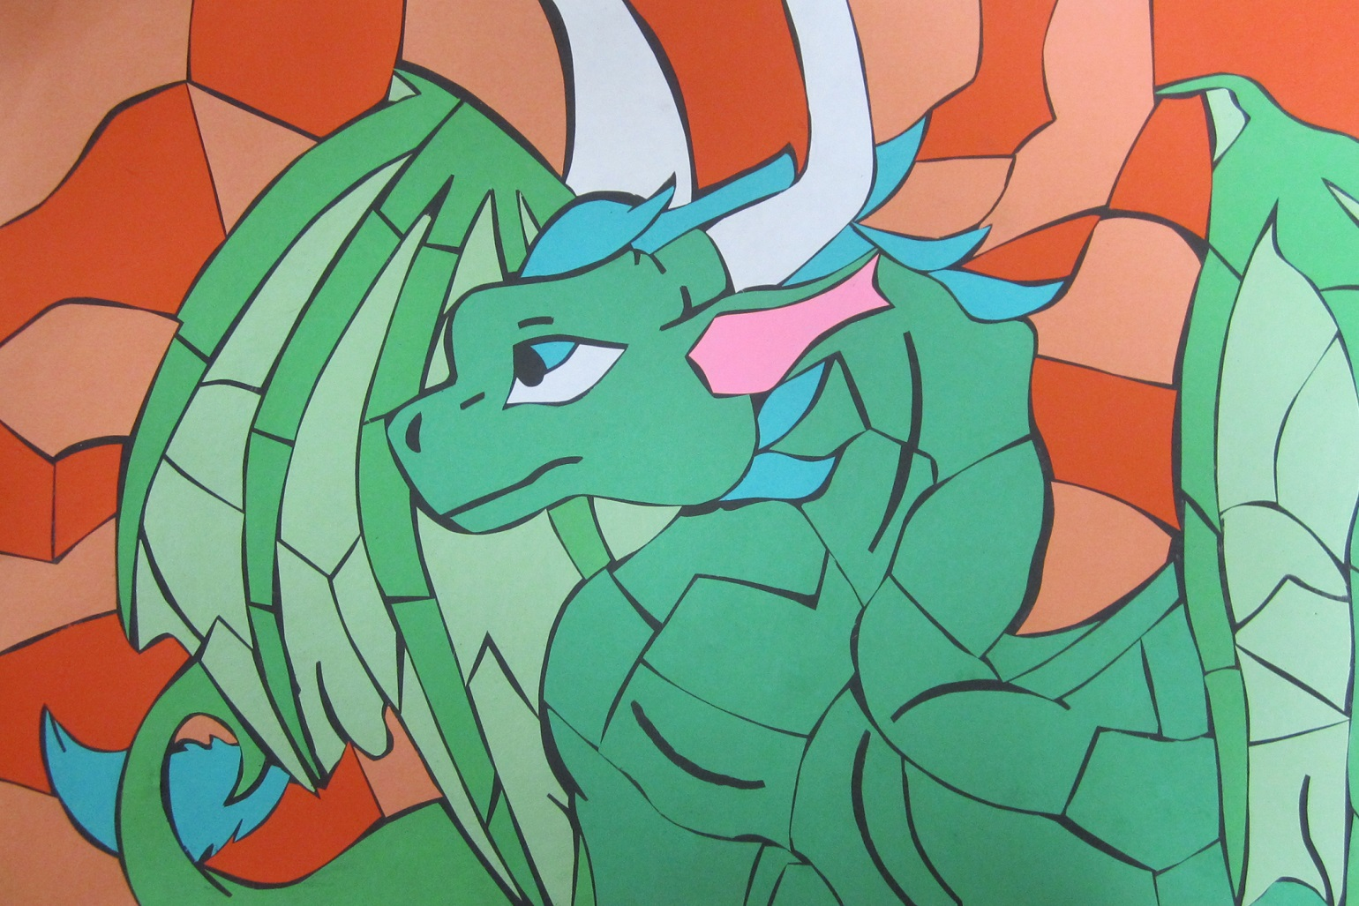
Student Examples

Slide 15

Student Examples

Slide 16

Student Examples

Slide 17
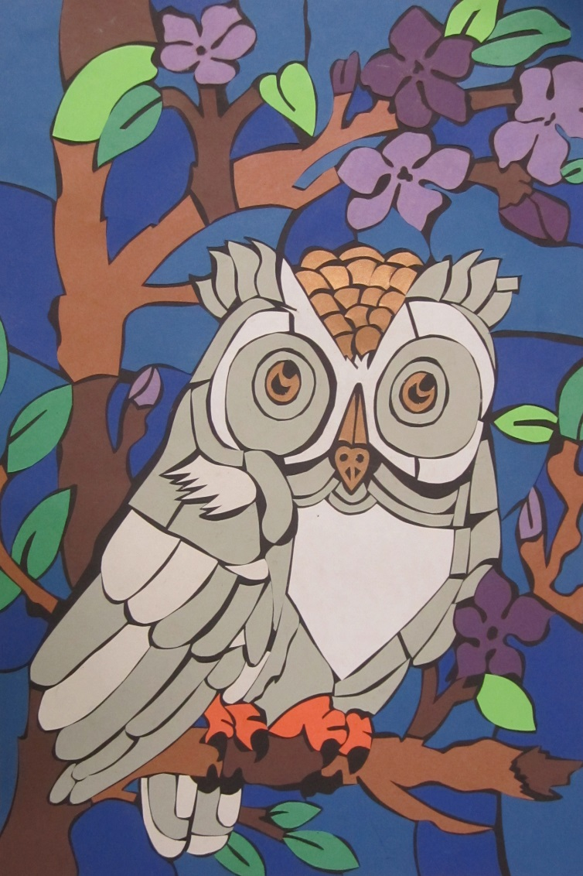
Student Examples

Slide 18
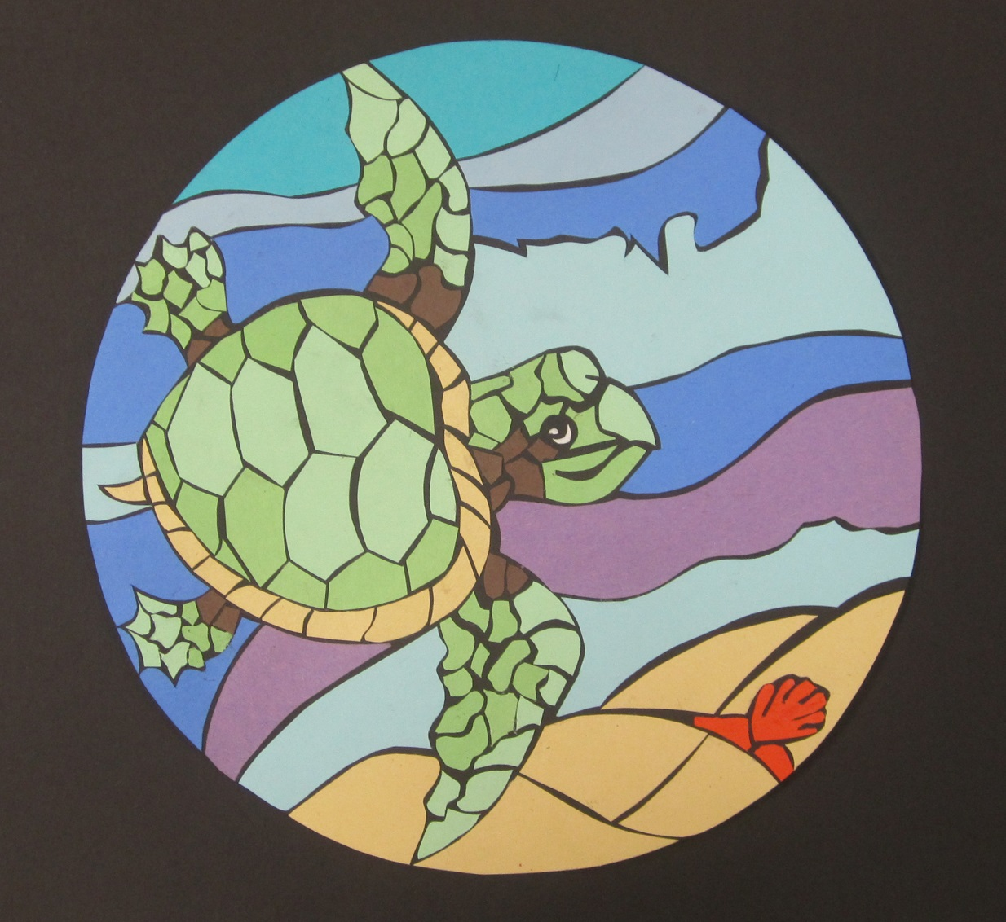
Student Examples

Slide 19

Student Examples

